Slide 1

NAVIQUEST USING PYTHON
Team Members:
1. Samson Jebaseelan C(811721104086)
2. Sarathy p(811721104090)
3. Yasheer Ahamed S(811721104125)
Guided By:
Dr.C.Shyamala M.E.,Ph.D..,
ASSOCIATE PROFESSOR

Slide 2
Content
1. Objective
2. Problem Statement
3. Existing System
4. Proposed System
5. Software & Hardware Requirements Specification
6. Literature Survey
7. Future Enhancement
8. Conclusion

Slide 3
Objective:
The primary objective of our project is to create an innovative solution that utilizes voice assistant technology to aid individuals who are new to our college campus in navigating their surroundings with ease and efficiency.
By integrating advanced voice recognition capabilities and intuitive interface design, we aim to develop a user-friendly system that allows users to simply speak their desired destination and receive clear, step-by-step directions.
Our overarching goal is to enhance the overall experience of students and visitors by providing them with a reliable and accessible tool for locating various facilities, buildings, and points of interest within our campus environment.

Slide 4
Problem Statement:
In the context of our college environment, newcomers often face challenges in familiarizing themselves with the campus layout, leading to confusion and inefficiency in navigation.
Furthermore, the dynamic nature of campus events and infrastructure updates necessitates a flexible and adaptable solution for guiding newcomers effectively.
Therefore, there is a pressing need for a modern, user-friendly navigation system that leverages voice assistant technology to offer intuitive, real-time guidance, facilitating seamless navigation for all individuals navigating our college campus

Slide 5
Existing System & Its Drawbacks:
Current navigation aids on campus include printed maps, static signage, and mobile map applications. These methods provide basic navigation assistance but lack interactivity and real-time updates.
Drawbacks
Static and Outdated Information: Maps and signage do not reflect real-time changes or temporary closures.
Limited Accessibility Features: Traditional aids are not designed to support visually impaired or cognitively challenged users.
Lack of Personalization: Existing tools do not offer personalized guidance based on user preferences or needs.

Slide 6
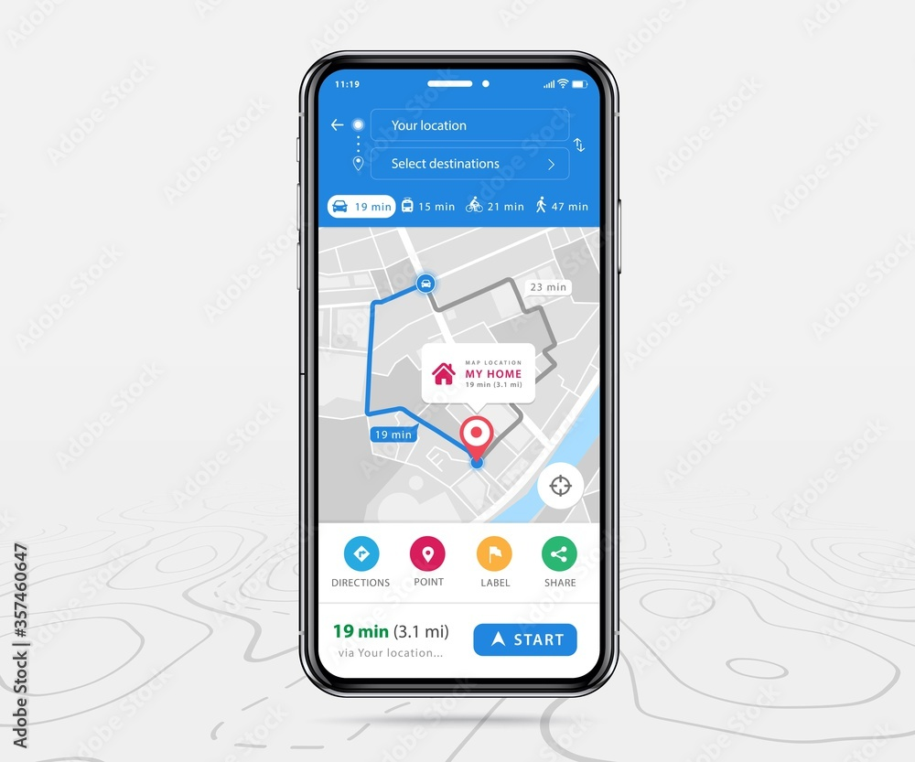
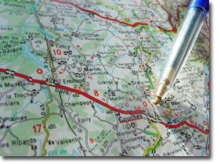
Existing System:

Slide 7
Proposed System & Its Advantages :
User Interface (UI):
This component manages the interaction between users and the virtual assistant. It can include a graphical user interface (GUI), a command-line interface (CLI), or integration with messaging platforms.
Speech Recognition:
If supporting voice commands, this component converts spoken language into text using speech recognition libraries or services.
Natural Language Processing (NLP):
Handles text understanding through tasks like tokenization, part-of-speech tagging, entity recognition, sentiment analysis, and intent recognition using NLP libraries like NLTK, spaCy, or Transformers.

Slide 8
Proposed System & Its Advantages :
Real-Time Navigation Assistance: Offers up-to-date directions and adjusts to changes in real-time.
Hands-Free Operation: Enables users to navigate without needing to look at maps or screens, enhancing accessibility.
Personalized User Experience: Tailors guidance based on user input and preferences, providing a more effective navigation experience.
Enhanced Accessibility: Designed to support users with visual or cognitive impairments, ensuring inclusivity.

Slide 9
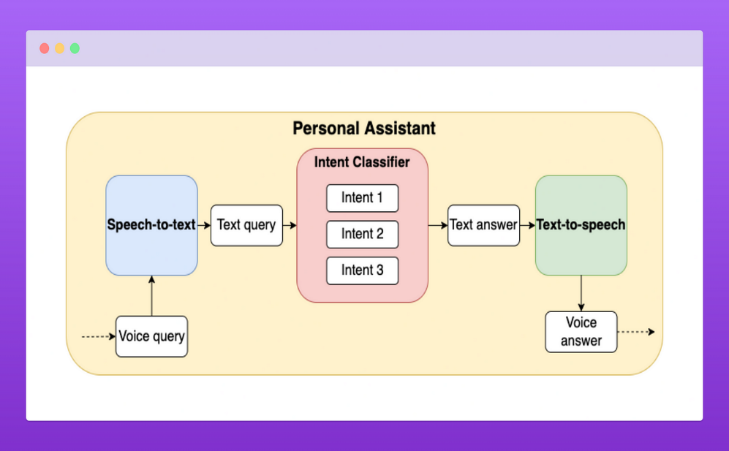
Proposed System Architecture:

Slide 10
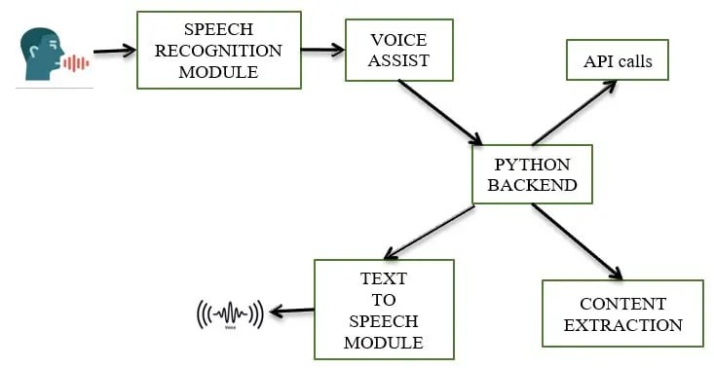
Proposed System Architecture:

Slide 11
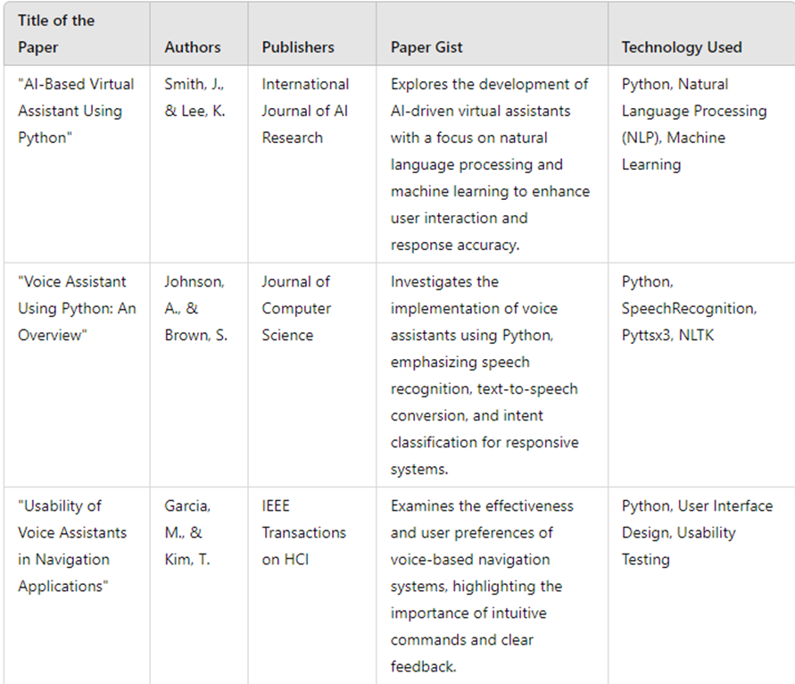
Litreature Survey:

Slide 12
Software & Hardware Requirements Specification :
HARDWARES
PC with 4-8GB RAM,128GB HDD or SSD.

Slide 13
FUTURE ENHANCEMENT:
1. Advanced Natural Language Understanding (NLU):
Enhance the assistant's NLU capabilities to understand complex user queries, contextual nuances, and varied languages or dialects.
2.Advanced Machine Learning Models:
Explore and integrate state-of-the-art machine learning models, such as transformer-based architectures (like GPT or BERT), to enhance language understanding and generation capabilities.
3.Multilingual Support:
Integrating additional languages to cater to a diverse user base.
4.Augmented Reality Integration:
Adding AR overlays for visual guidance and enhanced navigation experience.

Slide 14
Conclusion:
In conclusion, the development of NaviQuest represents a significant advancement in addressing the navigation challenges faced by newcomers to our college campus.
By harnessing the power of voice assistant technology, coupled with intuitive interface design and real-time location data, NaviQuest offers a user-friendly solution that empowers individuals to navigate our campus environment confidently and independently.
Through our comprehensive literature review and diligent implementation efforts, we have ensured that NaviQuest incorporates best practices from existing studies while also addressing specific needs and preferences of our target users.
Moving forward, the successful deployment and adoption of NaviQuest have the potential to not only enhance the overall experience of newcomers but also serve as a model for leveraging voice-enabled navigation systems in similar educational and public environments.

Slide 15
Thank you…

